Slide 1

DISASTER MANAGEMNT AND RESOURCE ALLOCATION SYSTEM
By Aditya Aggarwal
Reg no. - 2427030522

Slide 2
INTRODUCTION
A Disaster Management and Resource Allocation System is designed to efficiently handle and coordinate activities before, during, and after a disaster to minimize its impact on people, property, and the environment. It integrates technology, communication, and resource management to ensure timely response and recovery.

Slide 3
CURRENT SYSTEMS
1) USHAHIDI – Crowdsourced reporting platform
Pros
Enables rapid, low-cost collection of eyewitness reports (SMS, web, social), improving situational awareness in early hours.
Easy to deploy and widely adopted (many countries / events), good for community engagement.
Cons
Data quality and veracity issues (rumours, duplicate or malicious reports) require heavy moderation or verification.
Limited built-in geospatial/asset-management capabilities compared with full-fledged DM suites (needs integrations).

Slide 4
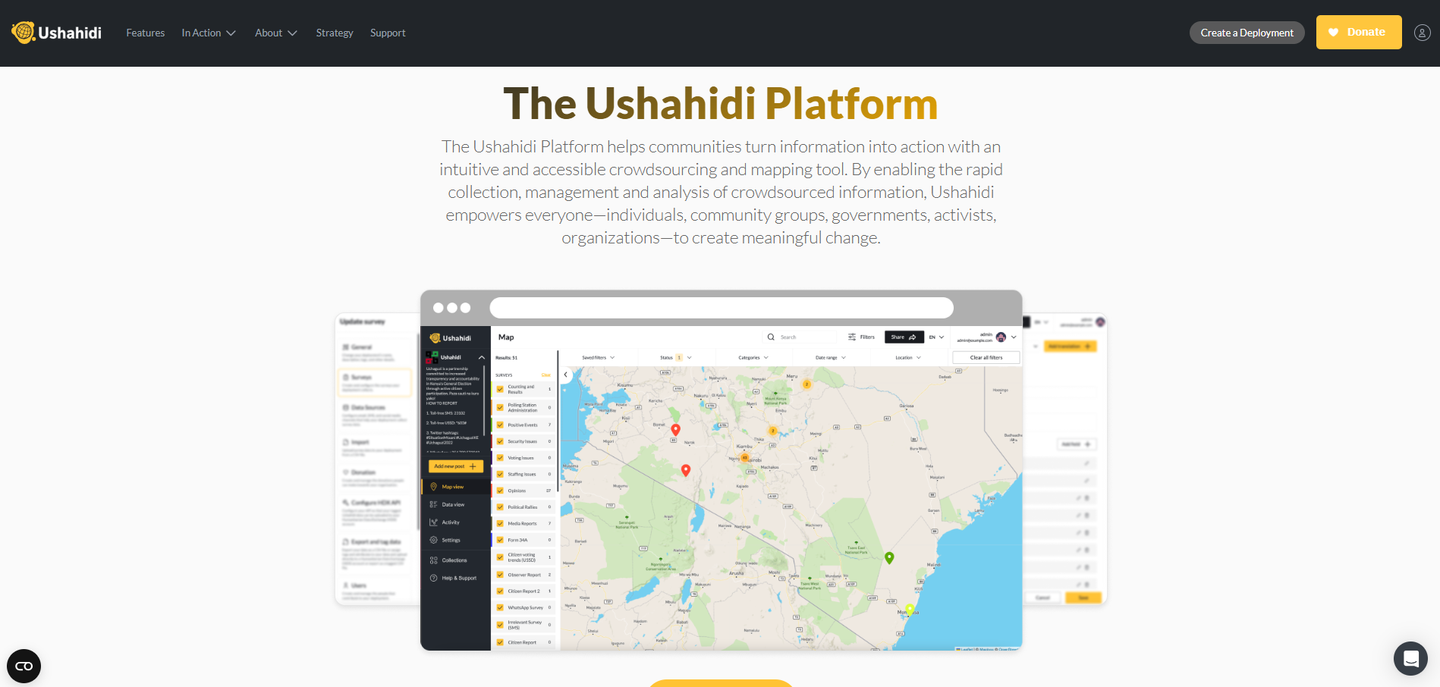

Slide 5
2) Sahana Eden — open-source disaster management system (coordination / asset/personnel tracking)
Pros
Feature-rich for coordination: shelters, hospitals, volunteers, inventories and geospatial layers — built specifically for DM workflows.
Open-source and extensible; strong track record in humanitarian deployments.
Cons
More complex to install/customize than lightweight tools; requires technical capacity for full value.
Usability and mobile UX can lag modern commercial SaaS unless customized.

Slide 6
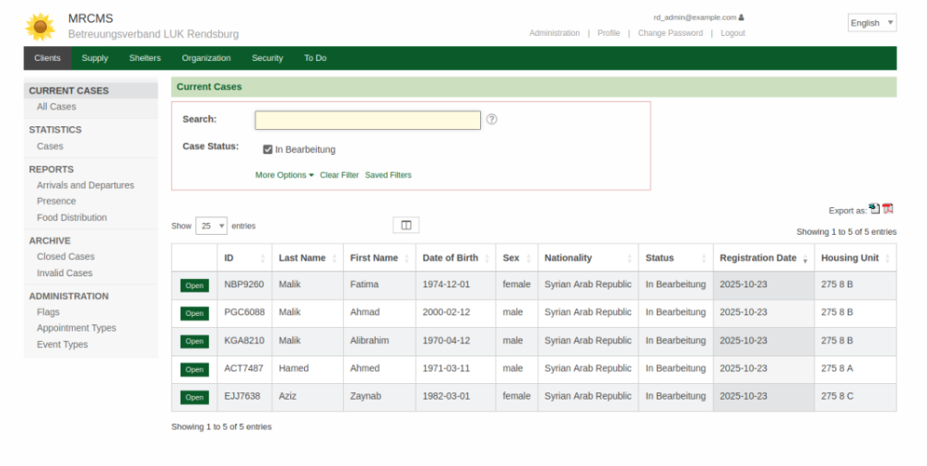

Slide 7
3) GDACS (Global Disaster Alert & Coordination System) — alert aggregation and coordination
Pros
Centralized rapid alerts and event severity estimates for earthquakes, cyclones, tsunamis — integrates satellite/sensor feeds for situational awareness.
Backed by UN/EU partnerships — trusted for international coordination.
Cons
Global-level alerts are coarse — local decision-makers still need localized, high-resolution data.
Not a full resource-allocation system (requires downstream integration with logistics/operations platforms).

Slide 8
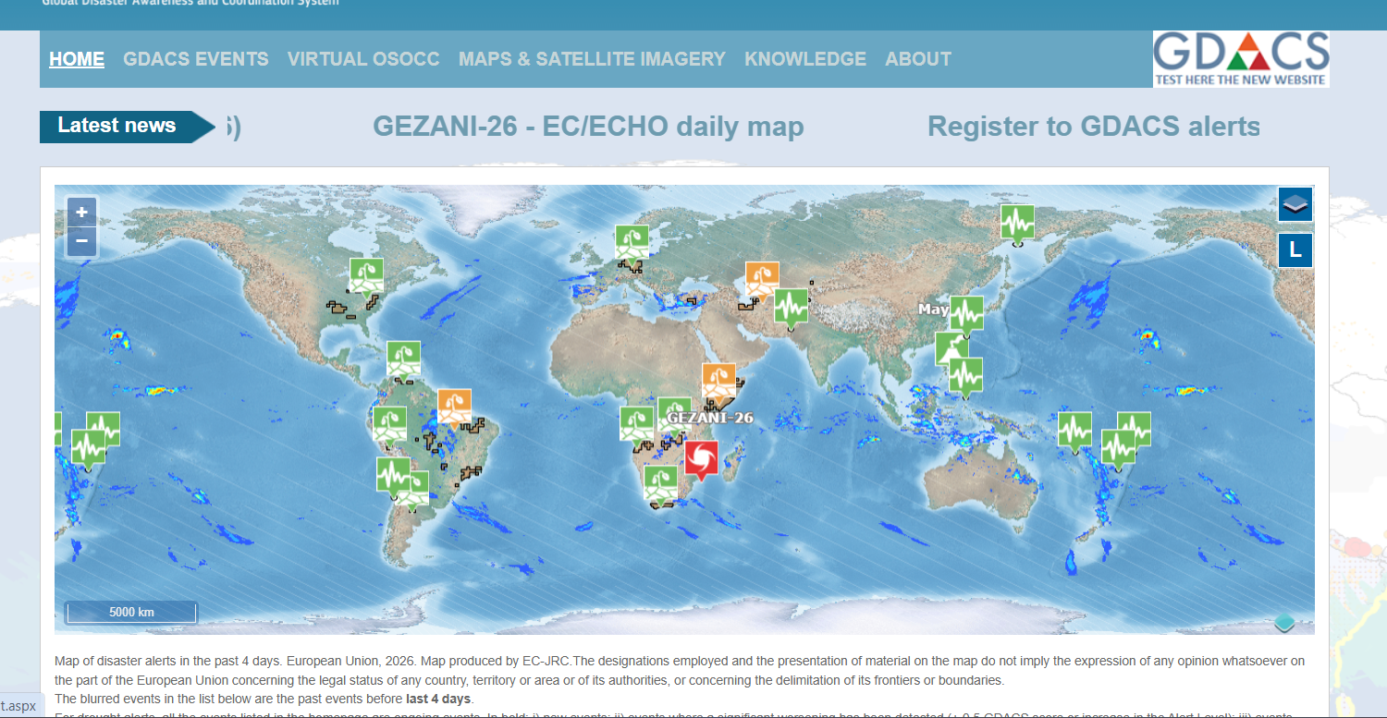

Slide 9
SOLUTION
My Solution is the Disaster Response and Resource Optimization System (DRROS).
The development of the Disaster Response and Resource Optimization System (DRROS) follows a systematic methodology that combines requirement analysis, data integration, intelligent modelling, system design, and validation to ensure an effective and robust solution. The methodology consists of the following steps:

Slide 10
1. Requirement Analysis and Problem Understanding
2. Data Collection and Source Integration Planning
3. System Architecture Design
4. Development of Event Detection and Prediction Models
5. Design and Implementation of Resource Optimization Algorithms
6. User Interface and Communication Module Development
7. System Integration and Interoperability Testing
8. Performance Evaluation and Validation
9. Deployment and Training
10. Continuous Monitoring, Updating, and Maintenance

Slide 11
ADVANTAGES
Advantages of DRROS Over Ushahidi
✔ Integrates multiple real-time data sources (IoT, satellite, sensors, government feeds)
✔ Includes AI-based prediction models
✔ Implements optimization algorithms (MILP, RL, heuristics) for resource allocation
✔ Provides a centralized coordination system
✔ Automated decision support instead of just report aggregation
✔ End-to-end disaster lifecycle support (detection → allocation → monitoring → analysis)

Slide 12
Advantages of DRROS Over Sahana Eden
✔ Built-in AI/ML-based severity detection and forecasting
✔ Advanced resource optimization module
✔ Modular multi-layer architecture (Data → Processing → AI → Application → Communication)
✔ Real-time dynamic allocation (not just tracking)
✔ Automated alert dissemination (SMS, push, broadcast)
✔ Designed for scalability (cloud/hybrid deployment)

Slide 13
Advantages of DRROS Over GDACS
✔ Provides localized, high-resolution decision support
✔ Integrates ground-level data (IoT, field reports)
✔ Performs real-time resource distribution planning
✔ Supports inter-agency coordination
✔ Maintains operational logs for post-disaster analysis
✔ Offers actionable deployment recommendations

Slide 14
FUTURE ROADMAP
PHASE 1: API + DATA INTEGRATION
PHASE 2: PILOT COLLABORATIONS
PHASE 3: APPLY VIA GOVERNMENT INNOVATION PROGRAMS
PHASE 4: SECURITY + COMPLIANCE
PHASE 5: PROVE REAL IMPACT

Slide 15
API INTEGRATION
Objective:
Transform DRROS into a system that can:
Plug into government data pipelines
Exchange data in real-time
Work with existing GIS + control room tools

Slide 16
GDACS + WEATHER API INTEGRATION
The system integrates real-time disaster data from GDACS, converts it into structured incidents, and uses a greedy optimization algorithm enhanced with weather-based weighting to allocate resources efficiently based on severity, distance, and environmental conditions.

Slide 17
Fetch GDACS events 🌍
↓
Convert to Incident objects
↓
Generate available resources 🚑
↓
Fetch weather for each incident 🌦️
↓
Calculate scores (severity + distance + weather)
↓
Allocate best resources
↓
Print results

Slide 18
Aspect | 🧪 Original Code | 🚀 Final Code
Incident Source | Random data | GDACS real-time data 🌍
Coordinates | Random | Real coordinates
Severity | Random | Based on alert level
Weather Factor | ❌ Not used | ✅ Used 🌦️
Scoring Formula | severity / distance | (severity × weather) / distance
System Type | Simulation | Real-world system
APIs Used | None | GDACS + Weather

Slide 19
PILOT COLLABORATIONS
We will run the DRROS System with real stakeholders(government/agencies) on a small scale pilot.
Target Authorities :-
District Magistrate
State Disaster Management Authority

Slide 20
GOVERNMENT INNOVATION PROGRAMS
Startup and Innovation Programs:-
Startup India
Atal Innovation Mission
Smart India Hackathon

Slide 21
SECURITY
Objective:
Make DRROS -
Secure (no data leaks / hacks)
Compliant (follows Indian laws)
Trustworthy (government can rely on it in crises)

Slide 22
REAL IMPACT
Proving efficiency of DRROS by running simulations on real life scenarios.
Key Metrics of this phase are –
1. Response Time
Time to allocate resources
2. Resource Utilization
% of resources effectively used

Slide 23
3. Allocation Accuracy
Right resources sent to right place
4. Coordination Efficiency
Number of communication delays
5. Prediction Accuracy
AI correctness

